Slide 1



Idiomatic Programmer Learning Keras
Computer Vision Workshop Version: July 2019

Slide 2
Idiomatic Programmer Learning Keras
Repo: github.com/GoogleCloudPlatform/keras-idiomatic-programmer
Workshops, Handbooks, and Model Zoo

Slide 3
Computer Vision Workshop - 2019
Session 1 : Models
Session 2 : Data Engineering
Session 3 : Training & Deployment
Each session is approximately 2 hrs, consisting of:
1 hr and 15 minute presentation and code-follow
20 minute post Q&A and Exercises
10 minute break / network

Slide 4
Computer Vision - Models
Part 1 : Covered in Neural_Network Study Pack
Part 2 : Covered in Convolutional_Neural Network Study Pack
Part 3 : Covered in Wide_Convolutional_Neural_Networks
Part 4: Covered in Advanced_Convolutional_Neural_Networks
Part 5: Mobile Convolutional Neural Networks

Slide 5
Advanced - Pre-Stems
Pre-Stems - Different Input Sizes
Generally, your input data is preprocessed into a specific shape for the target network architecture. But what if you want to reuse the image data preprocessed for one neural network on another with a different input shape, without reprocessing it.
The simplest approach would be to resize() the preprocessed image data, which could introduce the following issues:
The amount of computational time expended in re-processing the images.
Introduction of artifacts as a result of resizing, particularly if upsampled.
The conventional practice when reusing preprocessed image data for a stem that takes a different input shape is:
If the input shape of the new stem is smaller, then downsample (resize()) the preprocessed images (e.g., (299, 299, 3) => (224, 224, 3)).
If the input shape of the new stem is greater, then zero pad the image to enlarge the dimensions to the new shape (e.g., (224, 224, 3) => (230, 230 3). That is your adding an outer pad of zeros to match the shape.

Slide 6
Advanced - Pre-Stems
Pre-Stems - Stem Mismatch
Let’s now assume that we instead use the input shape (224, 224, 3) on the same stem, as in the code example below. In this case, the stem would output a 109 x 109 feature maps instead of 112 x 112 which the architecture was not optimized for.
This will be more problematic if the model has been pretrained (weights). The weights trained for the feature maps won’t match now.
from keras import layers, Input inputs = Input(shape=(224, 224, 3)) # this stem's expected shape is (230, 230, 3) x = layers.Conv2D(64, (7, 7), strides=(2,2))(inputs) X = layers.BatchNormalization()(x) x = layers.ReLU()(x) # this will output: (?, 109, 109, 64) print(x.shape)

Slide 7
Advanced - Pre-Stems
Pre-Stems - Stem Mismatch
Let’s now assume that we instead use the input shape (224, 224, 3) on the same stem, as in the code example below. In this case, the stem would output a 109 x 109 feature maps instead of 112 x 112 which the architecture was not optimized for.
from keras import layers, Input inputs = Input(shape=(224, 224, 3)) # this stem's expected shape is (230, 230, 3) x = layers.Conv2D(64, (7, 7), strides=(2,2))(inputs) X = layers.BatchNormalization()(x) x = layers.ReLU()(x) # this will output: (?, 109, 109, 64) print(x.shape)

Slide 8
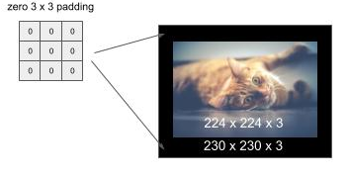
Pre-Stems - Zero Padding
Pre-Stems - Zero Padding
We fix this problem by adding padding around the input shape to match the input shape that the neural network architecture was optimized and/or trained for. In our example, we need to extend the 224 x 224 to 230 x 230. We can do this by adding a 3 x 3 pad (of zero values) around the image, as shown below:

Slide 9
Advanced - Pre-Stems - Zero Padding
Pre-Stems - Zero Padding
The code below demonstrates using the ZeroPadding2D() method for adding a pad, where the parameter (3, 3) specifies the height and width of the pad to place around the image.
from keras import layers, Input # not the input shape expected by the stem (which is (230, 230, 3) inputs = Input(shape=(224, 224, 3)) # pre-stem inputs = layers.ZeroPadding2D((3, 3))(inputs) # this will output: (230, 230, 3) print(inputs.shape) # this stem's expected shape is (230, 230, 3) x = layers.Conv2D(64, (7, 7), strides=(2,2))(inputs) X = layers.BatchNormalization()(x) x = layers.ReLU()(x) # this will output: (?, 112, 112, 64) print(x.shape)

Slide 10
Representational Equivalence
Representational Equivalence and Factorization
Factorization is decomposing a first block structure into smaller components which are representationally equivalent. The term representational equivalence means that the replaced design will maintain the same accuracy during training.
The goal of the factorization is to replace one design with another that is representationally equivalent but its computational complexity is less. The result is a smaller model to train, as measured by the number of weights, but retains the same accuracy.
The architectures for ResNeXt and for later versions of Inception relied on factorization. Typically, these factorizations are inferred through computational theory and then proved empirically.

Slide 11
DenseNet
DenseNet
DenseNet introduced the concept of a Densely Connected Convolutional Network. The corresponding paper won CVPR 2017 (Best Paper Award). It is based on the principal, that the output of each residual block layer is connected to the input of every subsequent residual block layer. This extends the concept of identity links.
Prior to DenseNet, an identity link between the input and output of a residual block was combined by matrix addition. In a dense block, the input to the residual block is concatenated to the output of the residual block. This change introduced the concept of feature (map) reuse.

Slide 12
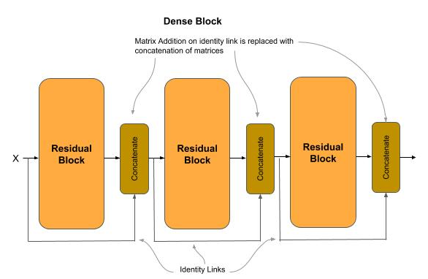
DenseNet - Feature Map Concatenation
DenseNet - Feature Map Concatenation
Let’s assume the output of a layer are feature maps of size 28 x 28 x 10. After a matrix addition, the outputs continue to be 28 x 28 x 10 feature maps. The values within them are the addition of the residual block’s input and output, and thus do not retain the original values (i.e., they have been merged). In the dense block, the input feature maps are concatenated (not merged) to the residual block output, and the original value of the identity link is preserved. In our example, assuming the input and output where 28 x 28 x 10, after the concatenation the output will be 28 x 28 x 20. Continuing to the next block, the output will be 28 x 28 x 30. In this way, the output of each layer is concatenated into the input of each subsequent layer (hence the reference to densely connected).

Slide 13
DenseNet - Feature Map Reuse
DenseNet - Feature Map Reuse
The replacing of the matrix addition with a concatenation has the advantages of:
Further alleviating the vanishing gradient problem over deeper layers.
Further reducing the computational complexity (parameters) with narrower feature maps.
With concatenation, the distance between the output (classifier) and the feature maps is shorter which reduces the vanishing gradient problem, allowing for deeper networks for higher accuracy.
The reuse of feature maps has representational equivalence with the former operation of a matrix addition, but with more narrow layers. With the narrower layers, the overall number of parameters to train is reduced.

Slide 14
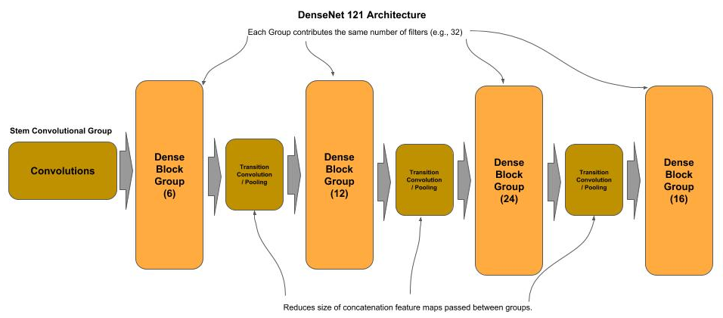
DenseNet - Transition Block
DenseNet - Transition Block
To further reduce computational complexity, a transition block is inserted between each dense block. The transition block is a strided convolution and feature pooling used to reduce the overall size of the concatenated feature maps (feature reuse) as they move from one dense group to the next. Below is a diagram of the DenseNet 121 architecture.

Slide 15
DenseNets - Dense Blocks
DenseNet - Dense Blocks
def dense_block(x, nblocks, nb_filters): # Construct a group of residual blocks for _ in range(nblocks): x = residual_block(x, nb_filters) return x def residual_block(x, nb_filters): shortcut = x # remember input tensor into residual block # Bottleneck convolution, expand filters by 4 (DenseNet-B) x = layers.Conv2D(4 * nb_filters, (1, 1), strides=(1, 1))(x) x = layers.BatchNormalization()(x) x = layers.ReLU()(x) # 3 x 3 convolution with padding=same to preserve same shape of feature maps x = layers.Conv2D(nb_filters, (3, 3), strides=(1, 1), padding='same')(x) x = layers.BatchNormalization()(x) x = layers.ReLU()(x) # Concatenate the input (identity) with the output of the residual block # Concatenation (vs. merging) provides Feature Reuse between layers x = layers.concatenate([shortcut, x]) return x

Slide 16
DenseNets - Dense Blocks
DenseNet - Building the Neural Network Architecture
def trans_block(x, reduce_by): # Reduce (compression) the number of feature maps (DenseNet-C) # shape[n] returns a class object. We use int() to cast it into the dimension size nb_filters = int( int(x.shape[3]) * reduce_by ) # Bottleneck convolution x = layers.Conv2D(nb_filters, (1, 1), strides=(1, 1))(x) x = layers.BatchNormalization()(x) x = layers.ReLU()(x) # Use mean value (average) instead of max value sampling when pooling reduce by 75% x = layers.AveragePooling2D((2, 2), strides=(2, 2))(x) return x # … OMITTED ... # Create the dense blocks and interceding transition blocks nb_filters = 32 for nblocks in blocks: x = dense_block(x, nblocks, nb_filters) x = trans_block(x, 0.5) # Add the last dense block w/o a following transition block x = dense_block(x, last, nb_filters) # … OMITTED ...

Slide 17
DenseNet121 vs ResNetX50
Comparing Complexity
Below is the ending of the summary() output. Note how the number of trainable parameters in this 121 layer DenseNet architecture is half of that of a 50 layer ResNeXt architecture.
In summary, this means that:
With ½ of the number of parameters we can train roughly in ½ of the time.
With more than double the number of layers (121 vs 50) we can train for more accurate results
Total params: 7,946,408 Trainable params: 7,925,928 Non-trainable params: 20,480

Slide 18
Xception
Xception
The Xception (Extreme Inception) architecture was introduced by Google in 2017 as a further improvement over the Inception v3 architecture. In this architecture the factorization of a convolution into a spatial separable convolution in an inception module is replaced with a depthwise separable convolution.

Slide 19
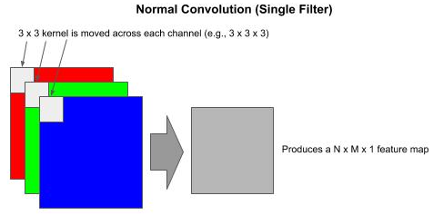
Xception
Normal Convolution
In a normal convolution, the kernel (e.g., 3 x 3) is applied across the height (H), width (W) and depth (D, channels). Each time the kernel is moved, the number of multiply operations equals the number of pixels as H x W x D.
On an RGB image (3 channels) with a 3 x 3 kernel done across all 3 channels, one has 3 x 3 x 3 = 27 multiply operations, producing a N x M x 1 (e.g., 8 x 8 x 1) feature map (per kernel), where N and M are the resulting height and width of the feature map.

Slide 20
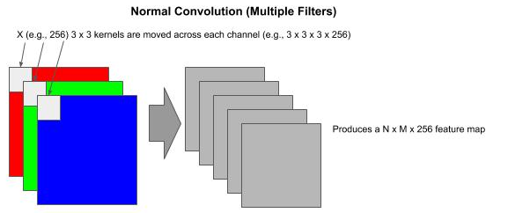
Xception
Normal Convolution (Multiple Filters)
If we specify 256 filters for the output of the convolution, we have 256 kernels to train. In the RGB example using 256 3x3 kernels, we have 6,912 multiply operations each time the kernels move.

Slide 21
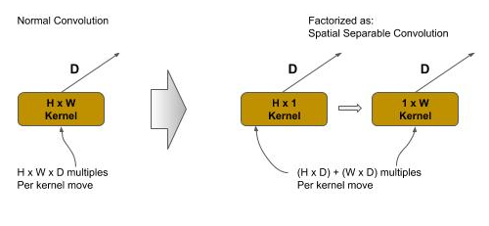
Xception - Spatial Separable Convolution
Spatial Separable Convolution
A spatial separable convolution factors a 2D kernel (e.g., 3x3) into two smaller 1D kernels. Representing the 2D kernel as H x W, then the factored two smaller 1D kernels would be H x 1 and 1 x W. It lowers the total number of computations by 1/3.
In the same RGB example with a factored 3 x 3 kernel, a spatial separable convolution would be (3 x 1 x 3) + (1 x 3 x 3) = 18 multiply operations each time the kernel is moved (vs. 27 in a normal convolution)

Slide 22
Xception - Depthwise Separable Convolution
Depthwise Separable Convolution
A depthwise separable convolution is used where a convolution cannot be factored into a spatial separable convolution without representational loss. A depthwise spatial convolution factors a 2D kernel into two 2D kernels, where the first is a depthwise convolution and the second is a pointwise convolution.

Slide 23
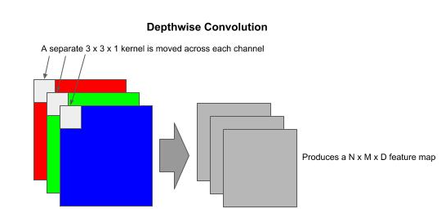
Xception - Depthwise Convolution
Depthwise Convolution
In a depthwise convolution the kernel is split into single H x W x 1 kernels, one per channel, and where each kernel operates on a single channel instead across all channels.
In the RGB example using a 3x3 kernel, a depthwise convolution would be three 3x3x1 kernels. While the number of multiply operations as the kernel is moved is the same as the normal convolution (e.g., 27 for 3x3 on three channels), the output is a D depth feature map instead of a 2D (depth=1) feature map.

Slide 24
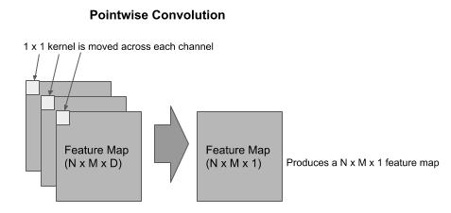
Xception - Pointwise Convolution
Pointwise Convolution
The output from a depthwise convolution is then passed as the input to a pointwise convolution, which forms a depthwise separable convolution. The pointwise convolution is used to combine the outputs of the depthwise convolution and expand the number of feature maps to match the specified number of filters (feature maps).
A pointwise convolution has a 1x1xD (number of channels). It will iterate through each pixel producing a N x M x 1 feature map, which replaces the N x M x D feature map.

Slide 25
Xception - Depthwise Separable Convolution
Computational Complexity
In the pointwise convolution we use 1x1xD kernels, one for each output. As in the early example, of our output is 256 filters (feature maps), we will use 256 1x1xD kernels.
In the RGB example using a 3x3x3 kernel for the depthwise convolution, we have 27 multiply operations each time the kernel moves. This would be followed by a 1x1x3x256 (where 256 is the number of outputted filters) which is 768. The total number of multiply operations would be:
Normal Convolution: 6912
Spatial Separable Convolution: 4608
Depthwise Separable Convolution: 795

Slide 26
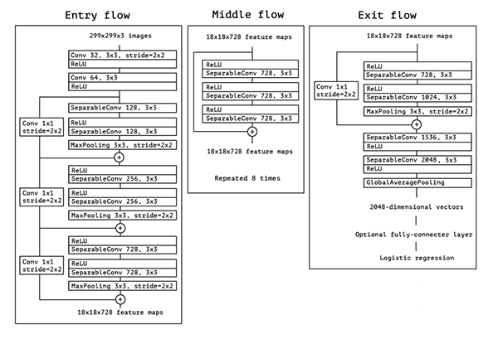
Xception - Architecture
In the Xception architecture, the spatial separable convolutions in the inception module are replaced with a depthwise separable convolution, reducing computational complexity (number of multiply operations) by 83%.

Slide 27
Xception - Architecture
Code snippet of a Keras implementation of a Depthwise Separable Convolution followed by a Pooling and Strided Convolution.
shortcut = x # First Depthwise Separable Convolution x = layers.SeparableConv2D(728, (3, 3), padding='same')(x) x = layers.BatchNormalization()(x) # Second Depthwise Separable Convolution x = layers.SeparableConv2D(1024, (3, 3), padding='same')(x) x = layers.BatchNormalization()(x) x = layers.ReLU()(x) # Create pooled feature maps, reduce size by 75% x = layers.MaxPooling2D((3, 3), strides=(2, 2), padding='same')(x) # Add strided convolution to identity link to double number of filters to # match output of residual block for the add operation shortcut = layers.Conv2D(1024, (1, 1), strides=(2, 2), padding='same')(shortcut) shortcut = layers.BatchNormalization()(shortcut) x = layers.add([x, shortcut])

Slide 28
Advanced CNN - Code Lab #4
Optional Code Lab - Get Familiar with Advanced Convolutional Neural Networks
Idiomatic Programmer - handbook 1 - Codelab 4.ipynb

